Slide 1
Keystone meeting: Changing Landscape of the Cancer Genome June 20 - 25, 2011 • Boston
Ron Shamir
Internal group meeting 3 Aug 2011

Slide 2
Workshop contents
Reports on progress of specific cancer projects
Technology updates
Practical computing workshop
Report on initial translational efforts: moving closer to the clinic
Some computational methods
Very high quality talks, summarizing huge ongoing efforts (many 50+ coauthors talks)

Slide 3
Bottom line first
Learned a lot. Great conference!
Tsunami of data but 1. manageable, 2. looking under the lamppost
Local mutations much more understood than rearrangements
Personalized sequence-based cancer treatment is here but 1. only at top centers, 2. for very few individuals, 3. scalability unclear
Vast room for sophisticated computations

Slide 4
The buzzwords: Terminology, resources
Actionable / Druggable mutations: such that the clinicians can act on (already have drugs targeting them)
Driver/Passenger mutations (more on this later)
Combination therapies: when individual drugs fail, try combinations (computation may help)
Chromothripsis (more on this later)
UCSC Cancer Genomics Browser
IGV (Integrated Genome Viewer)
ICGC, TCGA

Slide 5
ICGC: International Cancer Genome Consortium

Slide 6
TCGA: The Cancer Genome Atlas
Notes:
The Cancer Genome Atlas (TCGA) began as a three-year pilot in 2006 with an investment of $50 million each from the National Cancer Institute (NCI) and National Human Genome Research Institute (NHGRI). The TCGA pilot project confirmed that an atlas of changes could be created for specific cancer types. It also showed that a national network of research and technology teams working on distinct but related projects could pool the results of their efforts, create an economy of scale and develop an infrastructure for making the data publicly accessible. Importantly, it proved that making the data freely available would enable researchers anywhere around the world to make and validate important discoveries. The success of the pilot led the National Institutes of Health to commit major resources to TCGA to collect and characterize more than 20 additional tumor types.

Slide 8
A typical 2-step study methodology
Deep DNA sequencing of small number (10s) of individuals (Exome, or whole genome) with the particular cancer.
Ideally, both tumor and normal in each person
Identify genes that are mutated in them
Sequence these genes in a larger cohort (100s) with the same cancer
Get statistics on the mutation rates in the patient population
Saves on the sequencing costs, at the expense of missing some (hopefully infrequently mutated) genes

Slide 9
Wood et al. (Science 07)
Isolated DNA from tumors: 11 colorectal, 11 breast.
PCRed exons and sequenced them from 18K genes in the tumors (and 2 matching normal patient tissues).
Successful analysis of 97% of targeted amplicons
Mutations validated on a panel of 24 additional tumors of the same type

Slide 10
Wood et al. The Genomic Landscapes of Human Breast and Colorectal Cancers. Science 318, 1108 (2007);
A map of genes mutated in colorectal cancers, in which a few gene “mountains” are mutated in a large proportion of tumors while most “hills” are mutated infrequently.
The mutations in two individual tumors are indicated on the lower map. Note that most mutations are outside hills or mountains and may be harmless.

Slide 11
Cancer genome landscapes. Nonsilent somatic mutations are plotted in 2D space representing chromosomal positions of RefSeq genes. The telomere of the short arm of chromosome 1 is represented in the rear left corner of the green plane and ascending chromosomal positions continue in the direction of the arrow. Chromosomal positions that follow the front edge of the plane are continued at the back edge of the plane of the adjacent row, and chromosomes are appended end to end. Peaks indicate the 60 highest-ranking candidate cacner genes for each tumor type.The dots represent genes that were somatically mutated in the individual colorectal (A) or breast tumor (B) displayed. The dots corresponding to mutated genes that coincided with hills or mountains are black with white rims; the remaining dots are white with red rims. The mountain on the right of both landscapes represents TP53 (chromosome 17), and the other mountain shared by both breast and colorectal cancers is PIK3CA (upper left, chromosome 3).

Slide 12
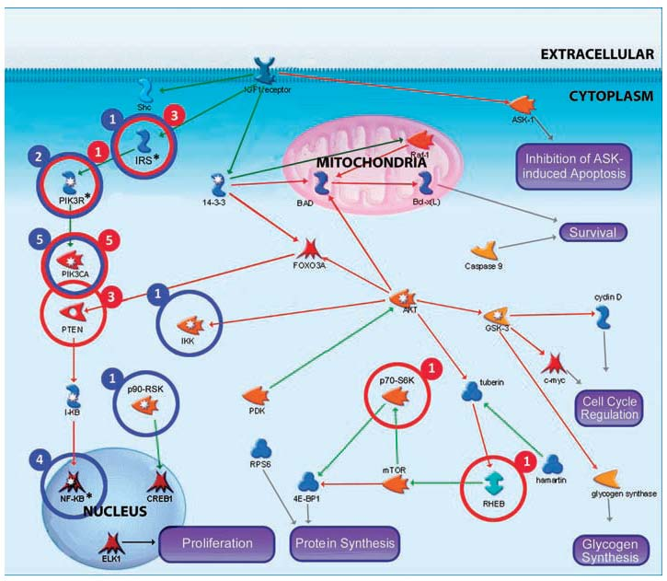
PIK3 pathway mutations in breast and colorectal cancers. The identities and relationships of genes that function in PI3K signaling are indicated. Circled genes have somatic mutations in colorectal (red) and breast (blue) cancers. The number of tumors with somatic mutations in each mutated protein is indicated by the number adjacent to the circle. Asterisks indicate proteins with mutated isoforms that may play similar roles in the cell. These include insulin receptor substrates IRS2 and IRS4; PIK3 regulatory subunits PIK3R1, PIK3R4, and PIK3R5; and NF-kB regulators NFKB1, NFKBIA, and NFKBIE.

Slide 13
Conclusions
About 80 mutations that alter amino acids in a typical cancer
A handful of common mutated gene “mountains”
A much larger number of infrequently mutated gene “hills”

Slide 14
Driver and Passenger mutations Greenman et al. Nature 07
‘Driver’ mutations
confer growth advantage on the cell in which they occur,
are causally implicated in cancer development
and have therefore been positively selected.
By definition, these mutations are in ‘cancer genes’.
‘Passenger’ mutations
have not been subject to selection.
They were present in the cell that was the progenitor of the final clonal expansion of the cancer
are biologically neutral
do not confer growth advantage
Distinguishing the two is a challenge

Slide 15
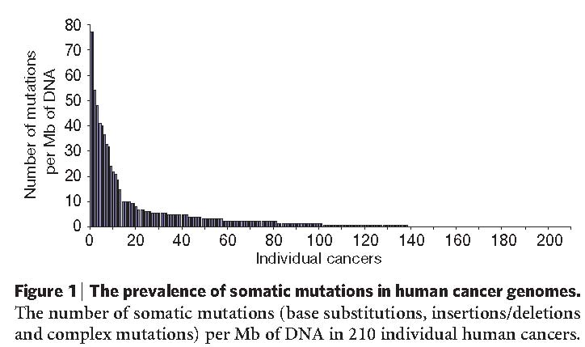
Somatic mutations prevalence Greenman et al. Nature 07
>1,000 somatic mutations found in 274 megabases (Mb) of DNA corresponding to the coding exons of 518 protein kinase genes in 210 diverse human cancers.
Gadi Getz (Broad): huge variance in mutation rate across cancer types: AML 0.1 to melanoma 100 mutations/MB

Slide 16
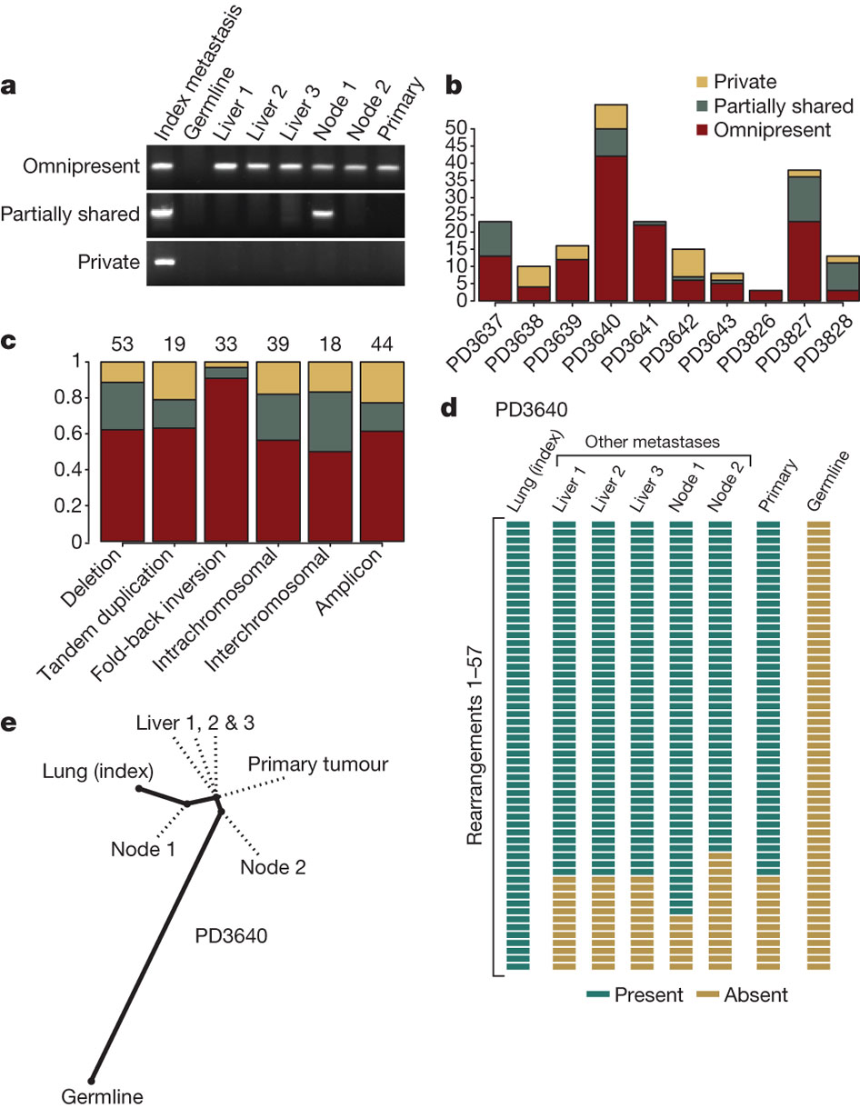
Phylogenetic relationships of different metastases within THE SAME patient.
PJ Campbell et al. Nature 467, 1109-1113 (2010) doi:10.1038/nature09460
Notes:
, PCR genotyping of three rearrangements across DNA from the index metastasis sequenced, other metastases from the same patient, the primary tumour and germline tissue. Somatic rearrangements may be present in all cancer samples but not the germline (omnipresent); present in some but not all metastases (partially shared); or present just in the index metastasis sequenced (private). b, Inter-individual differences in the proportions of rearrangements that are omnipresent across metastases, partially shared by some but not all lesions or are private to the index metastasis sequenced. c, Patterns across six broad categories of rearrangement in the proportions of variants that are omnipresent across metastases, partially shared by some but not all lesions or are private to the index metastasis sequenced. The numbers of rearrangements in each category are shown at the top. The difference in proportions between fold-back inversions and the other categories was statistically significant (P = 0.003). d, Genotyping of 57 rearrangements in PD3640 shows a coherent, nested structure, with 42 found in all metastases and the primary tumour, 7 found uniquely in the index tumour and 8 partially shared by some but not all metastases. e, The nested structure of rearrangements defines a phylogenetic tree of relationships among the metastases and primary tumour. The length of heavy black lines is proportional to the genetic distance between nodes. Dotted lines delineate the departure points of other, unsequenced lesions from the lineage between the germline genome and that of the index metastasis.

Slide 17
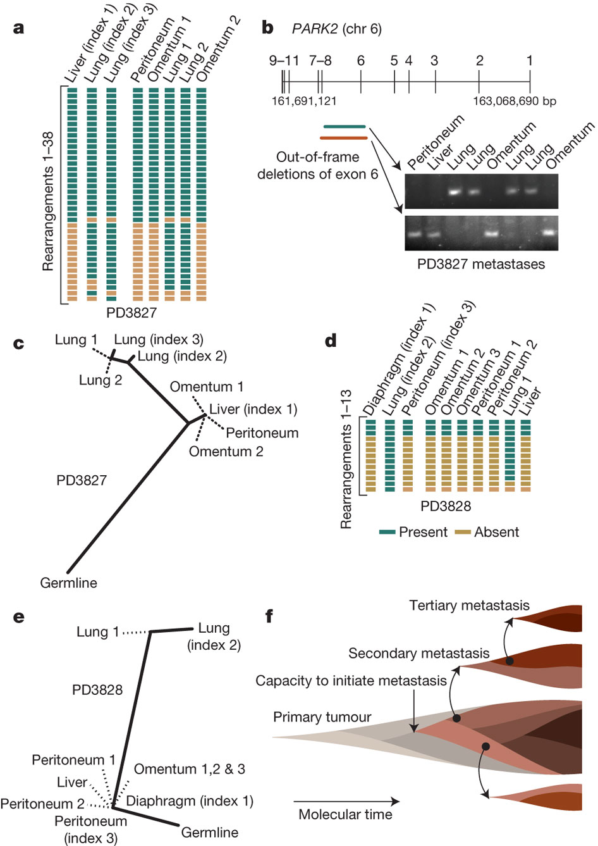
Organ-specific signatures of metastasis.
PJ Campbell et al. Nature 467, 1109-1113 (2010) doi:10.1038/nature09460
Notes:
Results of PCR genotyping for 38 rearrangements across the 3 index metastases and 5 other metastases from patient PD3827. b, Overlapping out-of-frame deletions of exon 6 of PARK2 were mutually exclusive to either the four lung metastases or the four abdominal metastases. The numbers above the gene refer to axon numbers and those below to the genomic position. c, A phylogenetic tree of relationships for metastases from patient PD3827, showing a clade of abdominal metastases and a further evolved clade of lung metastases. The length of heavy black lines is proportional to the genetic distance between nodes. Dotted lines delineate the departure points of other, unsequenced lesions from the lineage between the germline genome and that of the index metastasis. d, Results of PCR genotyping for PD3828. e, Phylogenetic tree of relationships for metastases from PD3828. f, Model for the clonal evolution of metastases derived from the patterns of phylogenetic relationships observed. Molecular time proceeds from left to right, and is associated with subclonal evolution and expansion within the developing primary tumour. Eventually a subclone within the primary tumour acquires the capacity to metastasize (pink), but this subclone continues to acquire genetic lesions (darkening shades of brown) such that different metastases may be founded from different clones. Within the developing metastases, clonal evolution continues, and these newly developed subclones can themselves seed tertiary metastases.

Slide 18
Model for the clonal evolution of metastases
PJ Campbell et al. Nature 467, 1109-1113 (2010) doi:10.1038/nature09460
Notes:
Results of PCR genotyping for 38 rearrangements across the 3 index metastases and 5 other metastases from patient PD3827. b, Overlapping out-of-frame deletions of exon 6 of PARK2 were mutually exclusive to either the four lung metastases or the four abdominal metastases. The numbers above the gene refer to axon numbers and those below to the genomic position. c, A phylogenetic tree of relationships for metastases from patient PD3827, showing a clade of abdominal metastases and a further evolved clade of lung metastases. The length of heavy black lines is proportional to the genetic distance between nodes. Dotted lines delineate the departure points of other, unsequenced lesions from the lineage between the germline genome and that of the index metastasis. d, Results of PCR genotyping for PD3828. e, Phylogenetic tree of relationships for metastases from PD3828. f, Model for the clonal evolution of metastases derived from the patterns of phylogenetic relationships observed. Molecular time proceeds from left to right, and is associated with subclonal evolution and expansion within the developing primary tumour. Eventually a subclone within the primary tumour acquires the capacity to metastasize (pink), but this subclone continues to acquire genetic lesions (darkening shades of brown) such that different metastases may be founded from different clones. Within the developing metastases, clonal evolution continues, and these newly developed subclones can themselves seed tertiary metastases.

Slide 19
Massive Genomic Rearrangement Acquired in a Single Catastrophic Event during Cancer Development
Stephens et al Cell 11

Slide 20
Clustered Rearrangements on Chromosome 4q in a Patient with Chronic Lymphocytic Leukemia

Slide 21
Rearrangements and Relapse
Notes:
(C) Genome-wide profile of rearrangements in a sample taken before chemotherapy. Chromosomes range round the outside of the circle, copy number changes
are shown by the blue line in the inner ring, and somatically acquired genomic rearrangements are shown as arcs linking the two relevant genomic points.
(D) Genome-wide profile of rearrangements from the same patient 31 months later, at relapse after therapy.

Slide 22
SNU-C1, a cell line from a colorectal cancer, carries 239 rearrangements involving chromosome 15

Slide 23
8505C, a thyroid cancer cell line, has 77 rearrangements involving chromosome 9p

Slide 24
Summary
2%–3% cancers show 10–100 s of rearrangements localized to specific genomic regions
Genomic features imply chromosome breaks occur in one-off crisis (“chromothripsis”)
Found across all tumor types, especially common in bone cancers (up to 25%)
Can generate several genomic lesions with potential to drive cancer in single event

Slide 25
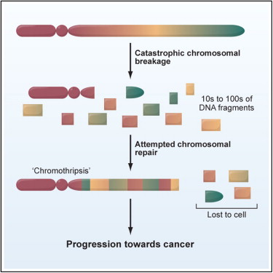

Slide 26
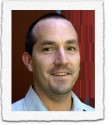
Inference of patient-specific pathway activities from multi-dimensional cancer genomics data using PARADIGM
Charles J. Vaske, Stephen C. Benz, J. Zachary Sanborn, Dent Earl, Christopher Szeto, Jingchun Zhu, David Haussler Joshua M. Stuart,
UC Santa Cruz, CA, USA
Bioinformatics 2010

Slide 27
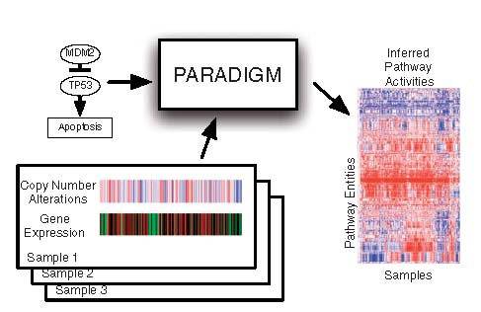
Overview
Input: patient expression and copy number profile; curated interaction networks
Goal: Infer patient-specific gene activity in specific pathways related to the cancer

Slide 28
Assumption s
If gene A is an activator and is upstream from B in some pathways,
their expression should be correlated
The copy number of A and the expression of B should be correlated, though less

Slide 29
Factor Graph representation of a pathway
Variables - states of entities in a cell, (e.g. a particular mRNA or complex)
represent the differential state of each entity in comparison with a ‘control’ or normal level.
Each of X={X₁, … X_{n} } is a random variable taking value -1, 0, or 1
Factors - interactions and information flow between these entities. Constrain the entities to take biologically meaningful values. j-th factor ϕ_{j} (X_{j}) is a probability distribution over a subset X_{j} of X
Joint probability distribution of all entities:
Notes:
Data on a single patient is integrated for a single gene using a set of
four different biological entities for the gene describing the DNA copies,
mRNA and protein levels, and activity of the protein

Slide 30
Toy example
Notes:
C. Toy example of
a small sub-pathway involving P53, an inhibitor MDM2, and the high level
process, apoptosis as represented in the model.

Slide 31
Model construction
Create a directed graph. For each gene, nodes: DNA, exp, protein, active protein
Edges have positive/negative label
Pos edges DNA →exp → protein → active-protein
Pos/neg edges active-prot1 → prot2 using the pathway info
For variable x_{j} add a factor ϕ_{j} (X_{j}) where X_{j}={x_{j}}∪Parents (x_{j})
Expected value is set by majority vote of parent edges: positive: +1*state, negative -1*state
Other rules for AND, OR relations

Slide 32
Inference & Learning
Observed variables:
DNA: copy number
mRNA: transcription
(Protein, active-prot: from proteomics)
Values discretized to ternary values
Different observed data D for each patient, same factor graph
Inference: Compute P(xi=a,D|Φ) using ML toolbox (tree inference, belief propagation)
Learning values of parameters: EM
Compute IPA: integrated pathway activity score per gene similar to log-likelihood ratios

Slide 33
Testing
Problem: Most NCI pathways are cancer related. Need surely negative pathways.
Created “decoy pathways” – same topology on random genes
Ran Paradigm and SPIA (Tarca et al 09) on the combination of real and decoy pathways. Used each method to rank all the pathways.

Slide 34
CircleMap of the ErbB2 pathway
For each node, ER status, IPAs, expression data and copy-number data are displayed as concentric circles, from innermost to outermost, respectively.
The apoptosis node and the ErbB2/ErbB3/neuregulin 2 complex node have circles only for ER status and for IPAs, as there are no direct observations of these entities. Each patient’s data is displayed along one angle from the circle center to edge.
Notes:
Fig. 7. CircleMap display of the ErbB2 pathway. For each node, ER status,
IPAs, expression data and copy-number data are displayed as concentric
circles, from innermost to outermost, respectively. The apoptosis node and
the ErbB2/ErbB3/neuregulin 2 complex node have circles only for ER status
and for IPAs, as there are no direct observations of these entities. Each
patient’s data is displayed along one angle from the circle center to edge.

Slide 35
Stacey Gabriel (Broad) – new sequencing technologies & Cancer

Slide 36
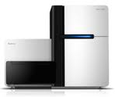
Illumina
 | Read length | Runtime | Bases/run | Reads/run | Raw error rate
Illumina | 76 | 10d | 500 Gb | 1.6B | 0.7%
 | 101 | 12d | 600 Gb | 1.6B | 0.9%
Whole genome – 400b inserts, ~100Gb/sample, average 30x
Did 100s to date
Exomes – 76b reads, ~200k selected exons using Sureselect (Agilent), 6Gb/sample, average 150x
Did >5000 to date
Transcriptome - 101b reads, ~Gb/sample, 200 samples per run.
Did a few to date

Slide 37
Prices (at the Broad)
WG $10K, 30x 500ng DNA
Exome $1600, 150x, 500ng DNA
RNAseq $1200, 1µg RNA
Prices include also manpower, computing, storage

Slide 38
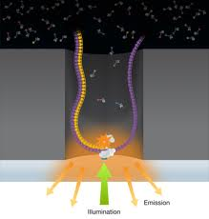
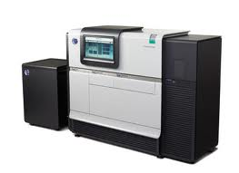
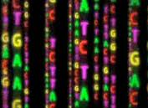
Pac Bio
 | Read length | Runtime | Bases/run | Reads/run | Raw error rate
Pacific Biosciences | 1500 | 1hr | 60Mb | 40K | 15%
No amplification – cyclic sequencing of the molecule corrects errors
Advantages: single molecule, long reads, short runtime
Applications: genome assembly, validation

Slide 39
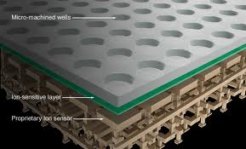
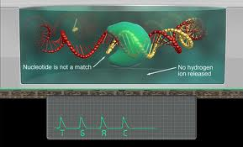
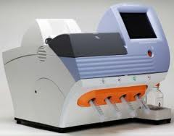
Ion Torrent
 | Read length | Runtime | Bases/run | Reads/run | Raw error rate
Ion Torrent | 100 | 3hr | 250Mb | 2.5M | 1-2%
Solid state technology. “World’s smallest PH Meter
Advantages: speed. Room for improvement in yield
Disadvantages – preparation process (emPCR), no paired ends.

Slide 40
Challenges
Missing genome regions (mainly due to high GC)
Sample preps, scalability, automation
Currently 50 samples per FTE per year
Reducing DNA quantities
went down from 3µg to 100ng without reducing library complexity
Beyond DNA: methylations, histone modifications, ChIP-seq, ….

Slide 41
Conclusions
 | Read length | Runtime | Bases/run | Reads/run | Raw error rate
Illumina | 76 | 10d | 500 Gb | 1.6B | 0.7%
 | 101 | 12d | 600 Gb | 1.6B | 0.9%
PacBio | 1500 | 1hr | 60Mb | 40K | 15%
Ion Torrent | 100 | 3hr | 250Mb | 2.5M | 1-2%
Sequencing is not the bottleneck
New platforms will complement the good old Illumina/Solid/454
Computation is not the bottleneck: it is becoming more efficient and more standard
But bear in mind that this is the perspective of one of the largest genome factories in the world.

Slide 42
Other vignettes from the conference
Ontario Inst. for Cancer Res, Tom Hudson:
1500 new genomes each month
50TB each month
Using PacBio (small DNA samples from biopsies)
Treating patients within three weeks (!)
More money spent on analysis than on sequencing and reagents
Five times more persons for analysis than for wetwork
Broad, Wendy Winkler
Correlation of RNAseq (using RPKM) and Affy gene expression levels: 0.4-0.8
Using RNAseq <45% of the reads are mapped to exons

Slide 43
Vignettes (2)
V. Velculscu (Johns Hopkins): Every five months, the number of bases that can be sequenced for 1$ doubles

Slide 44
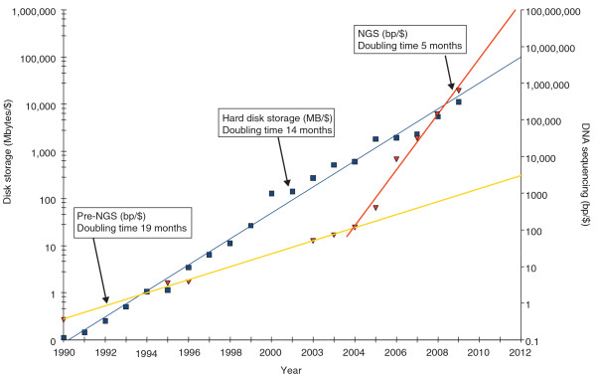
The impending collapse of the genome informatics ecosystem L Stein Genome Biology 2010, 11:207

